Slide 1
A diet high in saturated fat is linked to the incidence of atherosclerosis. If scientists wanted to test this relationship in laboratory rats they would design an experiment.
Write a suitable hypothesis for this experiment.
What would be the independent variable?
What would be the dependent variable?
List four factors that would need to be controlled.
How could the reliability of the experiment be improved?

Slide 2
As part of a laboratory report, a student drew the graph shown above to show the effect of temperature on enzyme activity.
The student made many mistakes while drawing the graph. List as many mistakes as you can.
Explain why a higher than optimum temperature will reduce the activity of an enzyme. Use the terms substrate and active site in your answer.
Explain why salivary amylase is not active in the stomach.

Slide 3
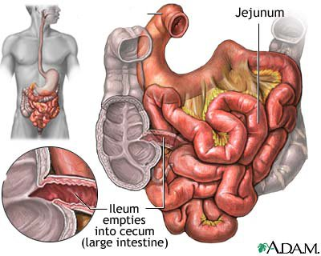
Below is a diagram of the small intestine.
What is the name given to the first part of the small intestine, labelled 1?
Describe how the internal surface of the small intestine is modified to enhance absorption.
Describe the process of protein digestion in the small intestine.
1

Slide 4
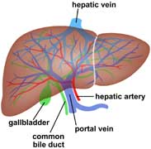
Explain how bile and lipase work together to efficiently digest fat.
Describe the structural differences between the hepatic artery and a capillary in the liver. Relate the structural differences to the function of each blood vessel.
The hepatic portal vein directly connects the small intestine and the liver. Discuss the differences in the relative concentration of oxygen, carbon dioxide and glucose between the hepatic portal vein, the hepatic vein and the hepatic artery.

Slide 5
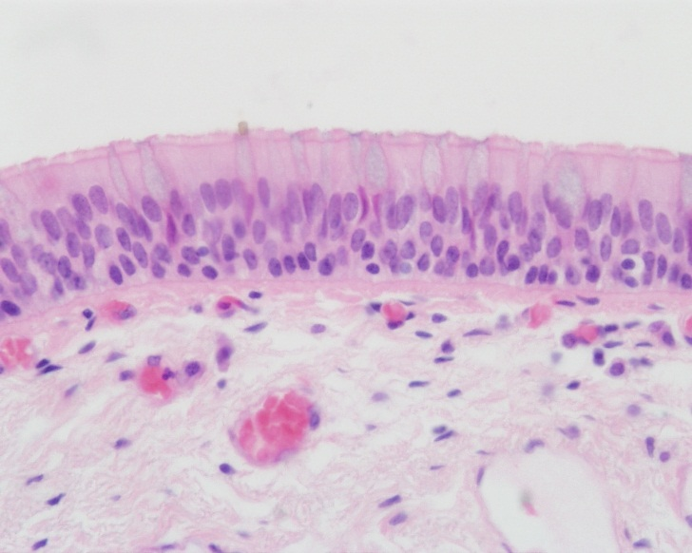
The photo below shows the lining of the trachea as seen down a microscope.
Name the airways that branch directly from the trachea.
Name the structures on the surface of the cells (see arrows).
Describe the role these structures play in the respiratory system.
Explain why no significant gas exchange occurs between the air in the trachea and the blood in the surrounding capillaries.

Slide 6
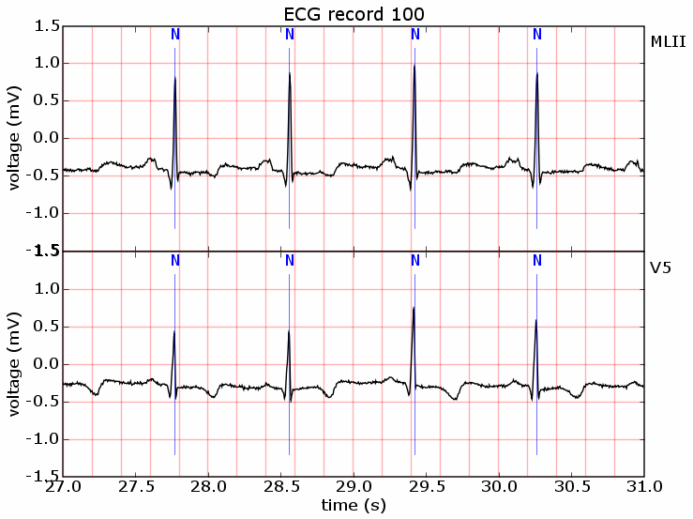
Is the person’s heart rate greater than 60bpm?
Name the part of the ECG trace that represents the point of highest blood pressure.
What is the name given to the higher blood pressure reading?
During the P-wave which valves are opening?
If the sino-atrial node increased its rate of firing, what would happen to the distance between two consecutive QRS complexes?

